Slide 1
Cardiovascular Disorders 3
Congenital Heart Defects

Slide 2
Main pathophysiological features of common congenital heart defects
Anatomical malformations of the heart and/or big vessels, present at birth
Major cause of neonatal death (after prematurity)
Two major pathophysiological types:
Cyanotic (causing blue color of skin caused by hypoxemia and/or hypercapnia): more severe
Acyanotic (“non-cyanotic”): less severe

Slide 3
Congenital heart defects (CHD)
Cause known in only 10% (Prenatal, environmental, and genetic risk factors)
Maternal rubella: especially in 1st trimester (formation of organs including heart)
Increased maternal age: 35+ yrs due to chromosomal alterations
Prematurity
Intrauterine infections (“TORSCHH”): Toxoplasmosis, Rubella, Syphilis, CMV, Herpes, HIV
Down syndrome
Chronic maternal alcohol intake
Diabetes Mellitus type 2
High altitude: increases risk of PDA

Slide 4
If CHDs are not corrected…
Chronic hypoxemia
Respiratory difficulty/failure
Heart failure
induce growth delays
especially with left heart dysfunction
death

Slide 5
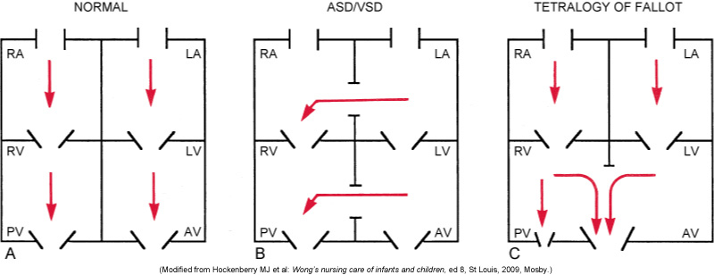
ACYANOTIC
CYANOTIC
Venous
Blood
Arterial
Blood
Venous
Blood
Arterial
Blood
Venous
Blood
Arterial
Blood
Shunt: abnormal movement of blood from one side of the heart to the other
Pressure drives the direction of the shunt
Right
Chambers
Left
Chambers
Right
Chambers
Left
Chambers
“Left-to-Right Shunt”
“Right-to-Left Shunt”

Slide 6
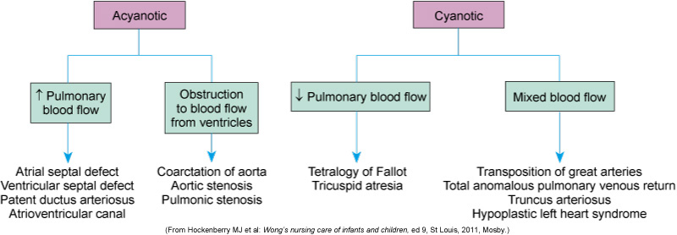
common congenital heart defects

Slide 7
Patent/Persistent Ductus Arteriosus
Ductus arteriosus (DA): connects pulm artery with aorta
usually closes 15 hr-14 days post-birth (constricts due to pressure changes)
Stimulus to close occurs with oxygenation of pulmonary vein with first breathes in new born (so in high altitudes, PDA more common due to lower atmospheric O2)
Patent/Persistent Ductus Arteriosus (PDA)
DA does not close within first month of life
Happens in up to 20% of premature babies
Causes L-to-R shunting (aorta to pulm artery)
Up to 10% associated with other CHDs
Causes a murmur

Slide 8
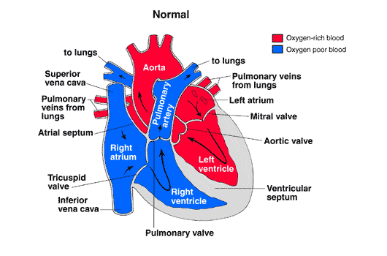
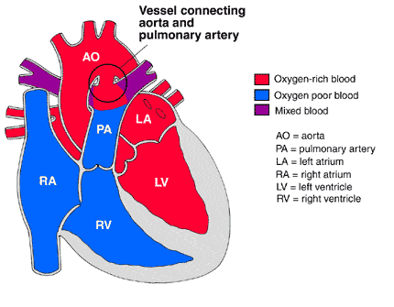
Consequences of Patent/Persistent Ductus Arteriosus (PDA)
Left to right shunt
Acyanotic defect
Increased blood flow to lungs
Congestive heart failure (eventually)

Slide 9
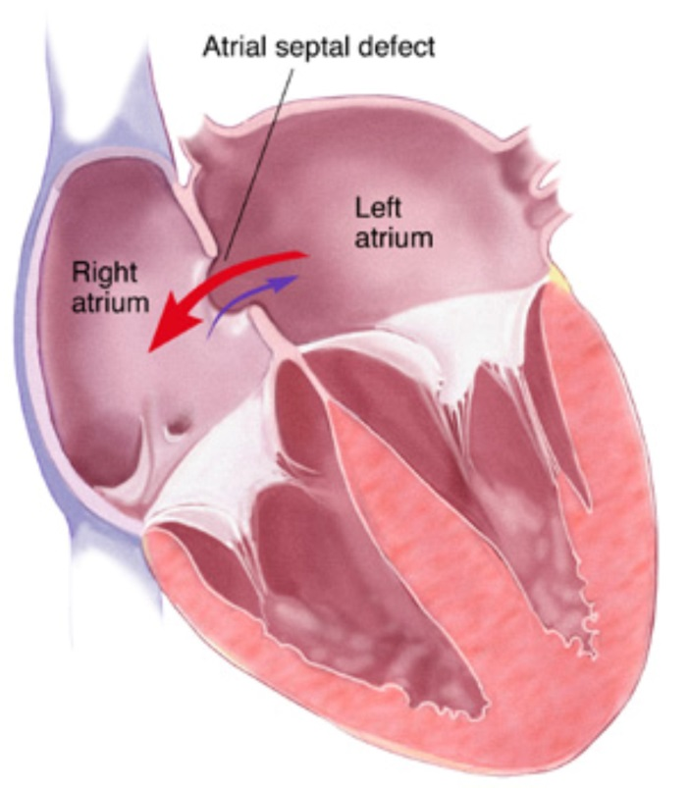
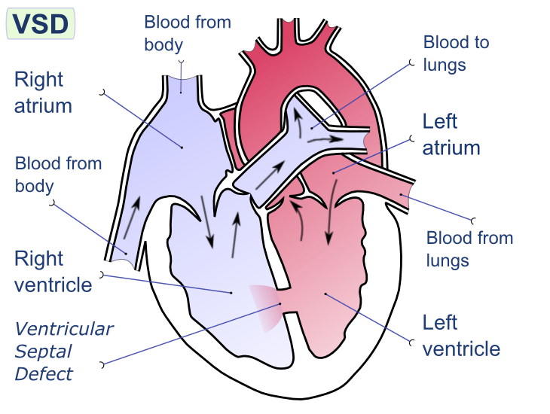
Septal Defects: Atrial (ASD) or Ventricular (VSD)
Atrial septal defect (ASD): more common & asymptomatic
Ventricular septal defect (VSD) : pulm hypertension
Left to right shunting: acyanotic
Causes a murmur

Slide 10
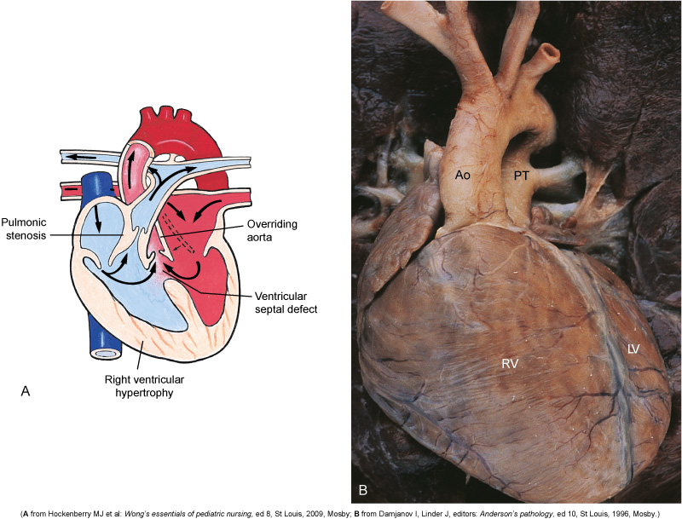
Tetralogy of Fallot
Four CHDs at once:
Pulmonary valve stenosis (major defect)
Right ventricular hypertrophy
VSD
Overriding aorta (minor cause of altered function)
1, 2 & 3 together cause R-to-L shunt
(most often)

Slide 11
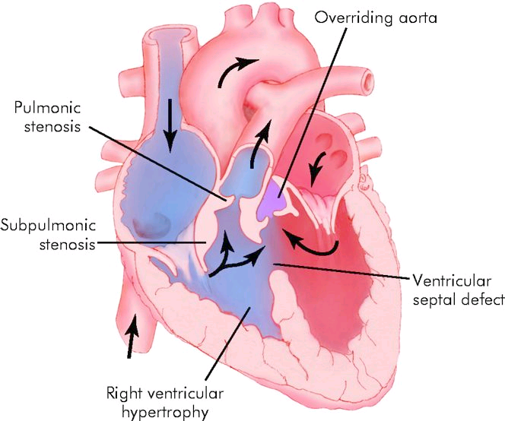
Tetralogy of Fallot
Change of aorta position over the VSD
Leads to RV hypertrophy
VSD, RV hypertrophy and PS leads to R to L shunt
Due to PS

Slide 12
Tetralogy of Fallot
Pulmonary stenosis
⇩ blood flow to lungs
⇩ oxygenation
RV hypertrophy
R to L shunt
via VSD
Leads to cyanotic defect
Clinical manifestation
Acute cyanosis (newborn)
Acute episodes of cyanosis & hypoxia (older)
Compensation mechanism
Polycythemia
Develop new bronchial blood vessel
⇧ blood in RV

